Slide 1
Capstone Engagement
Assessment, Analysis, and Hardening of a Vulnerable System
Prepared by Collin McClellan

Slide 2
Table of Contents
This document contains the following sections:
01
Network Topology
02
Red Team: Security Assessment
03
Blue Team: Log Analysis and Attack Characterization
Hardening: Proposed Alarms and Mitigation Strategies
04

Slide 3
Network Topology
‹#›

Slide 4
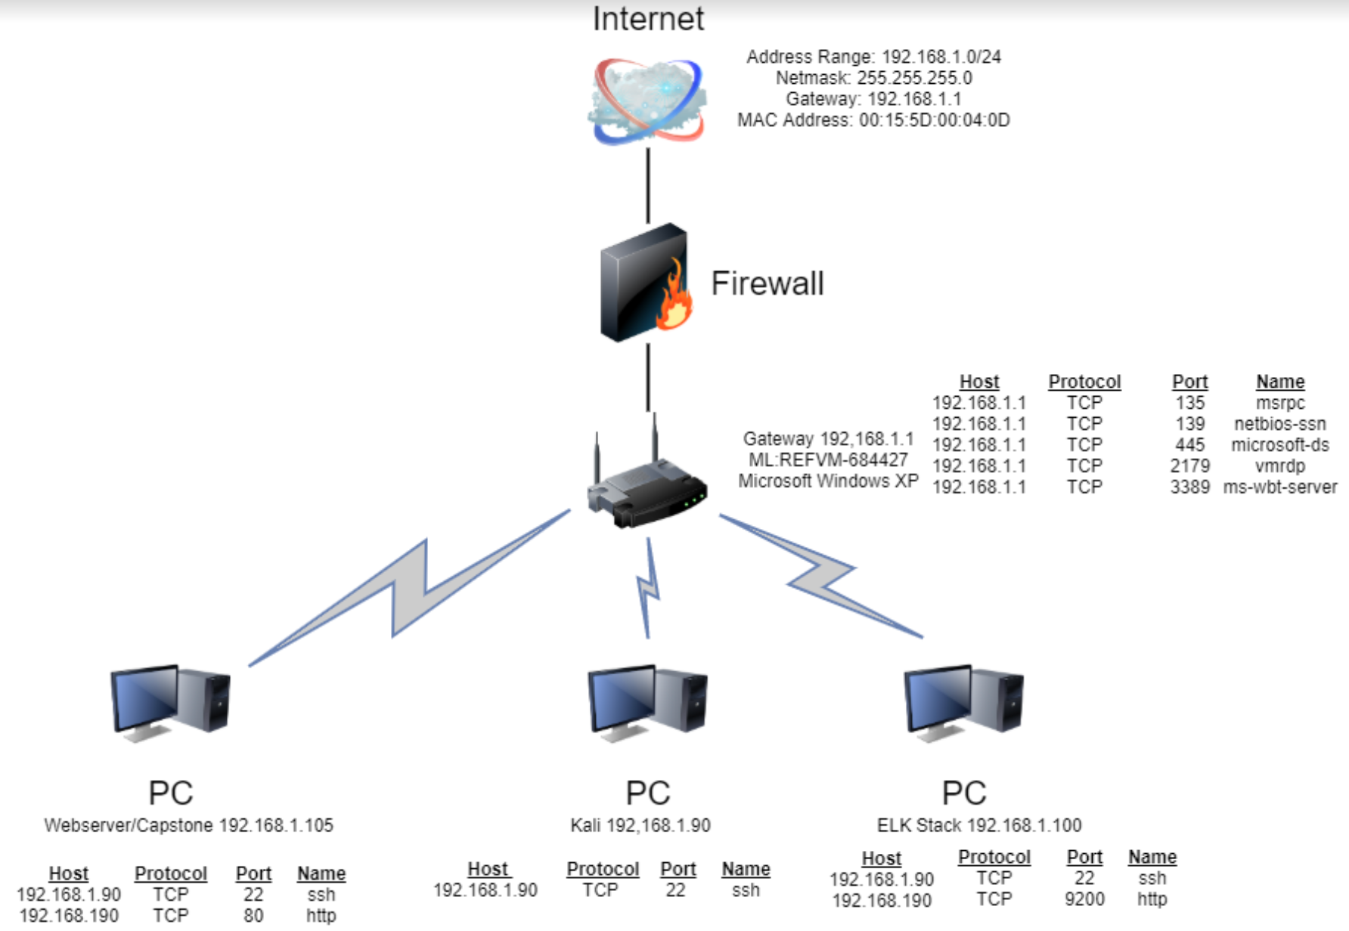
Network Topology
Network Address Range: 192.168.1.0/24 Netmask: 255.255.255.0 Gateway: 192.168.1.1
Machines IPv4: 192.168.1.1 OS: Windows Hostname: Router
IPv4: 192.168.1.90 OS: Linux Hostname: Kali
IPv4: 192.168.1.100 OS: Linux Hostname: ELK Stack
IPv4: 192.168.1.105 OS: Linux Hostname: Webserver/Capstone

Slide 5

Red Team
Security Assessment
‹#›

Slide 6
Recon: Describing the Target
Nmap identified the following hosts on the network:
Hostname | IP Address | Role on Network
ML-RefVm-684427 | 192.168.1.1 | Gateway
ELK Stack | 192.168.1.100 | Network Security Monitor
Capstone | 192.168.105 | Webserver
Kali | 192.168.1.90 | Attacker

Slide 7
Vulnerability Assessment
The assessment uncovered the following critical vulnerabilities in the target:
Vulnerability | Description | Impact
Weak Password Susceptible to Brute Force | Passwords were easily cracked using Hydra and common dictionary. System settings allowed unlimited password attempts. No failed attempt lockout was set which allowed for a brute force attack. | An LFI vulnerability allows attackers to gain access to sensitive credentials
Sensitive Data Exposure | Could access the company files through web browser. | Confidential information was accessible to malicious actor.
Password Hashes stored in company folders. | You could access password hashes on the browser | Allow unauthorized access to company folders.

Slide 8
Exploitation: Weak Password Susceptible to Brute Force
01
02
Tools & Processes
How did you exploit the vulnerability? We knew to look for Ashton’s login because the prompt included “For ashton’s eyes only”. We used Hydra to successfully crack Ashton’s password with the rockyou.txt
Command used: hydra -l ashton -P /usr/share/wordlists/rockyou.txt -s 80 -f -vV 192.168.1.105 http-get/company_folders/secret_folder
Achievements
We were able to discover ashton’s password is leopoldo. We successfully logged into the company folders as Ashton

Slide 9
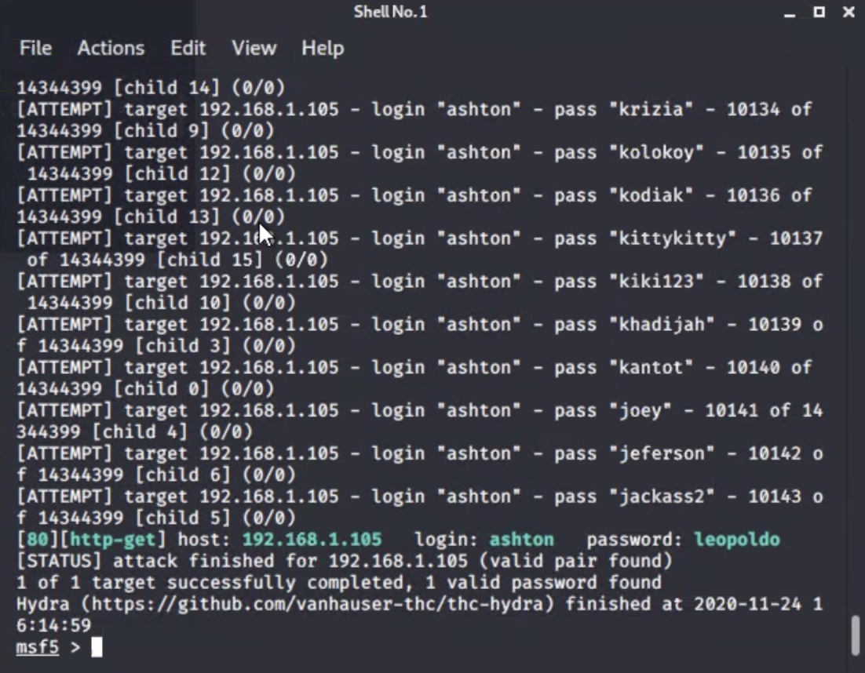
Exploitation: Weak Password Susceptible to Brute Force
Screenshot:

Slide 10
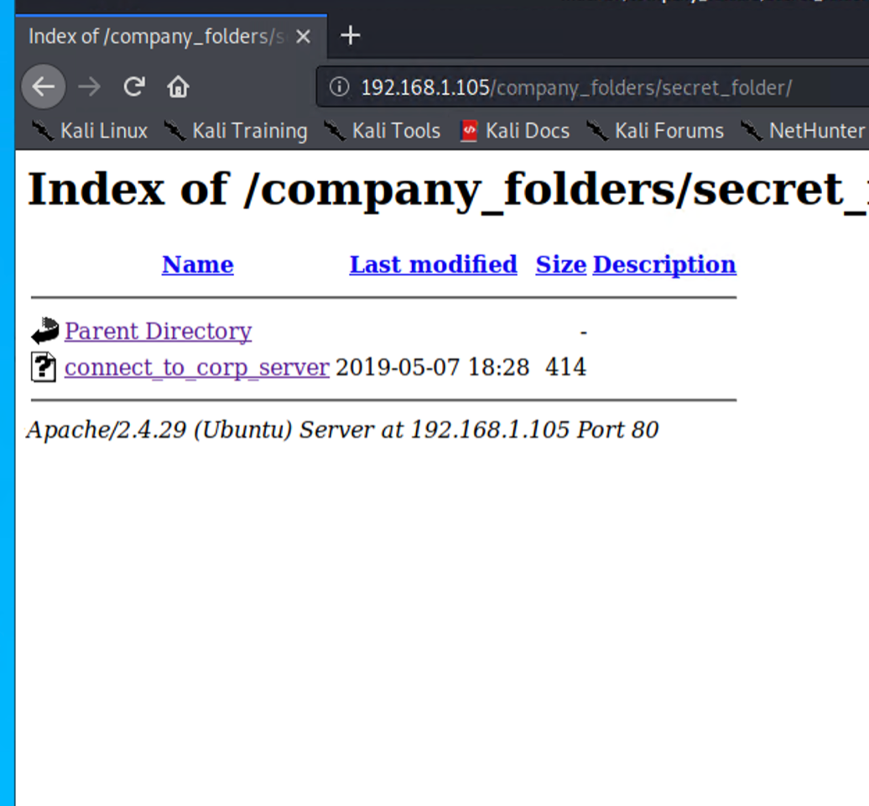
Exploitation: Sensitive Data Exposure
01
02
03
Tools & Processes
We navigated to 192.168.1.105. We were able to login to the company folders with Ashton’s password from the brute force attack revealing the secret company folders.
Achievements
We successfully navigated to the IP address
[INSERT: screenshot or command output illustrating the exploit.]

Slide 11
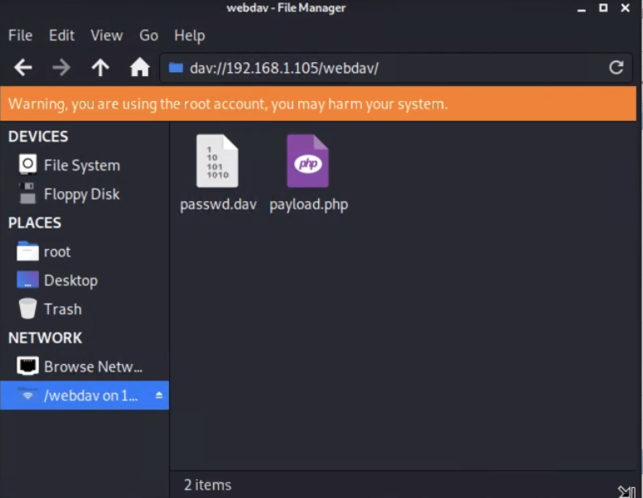
Exploitation: Password Hashes stored in company folders
01
02
03
Tools & Processes
We logged in as Ashton and selected “connect to corp server”. A personal note was left about using ryan’s account with a hash. We used crackstation to interpret the hash to “linux4u”. We used crackstation to successfully exploit ryan’s password from the hash left from Ashton’s personal note.
Achievements
Using ryan’s name and password, we were able to successfully logon to the company server via WebDAV (dav://192.168.1.105webdav) in file manager.
[INSERT: screenshot or command output illustrating the exploit.]

Slide 12

Blue Team
Log Analysis and Attack Characterization
‹#›

Slide 13
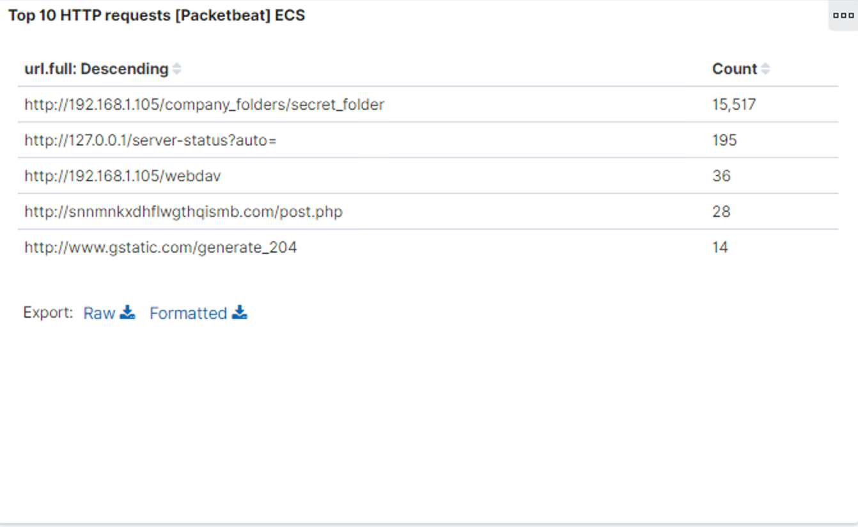
Analysis: Identifying the Port Scan
The port scan occurred on December 6, 2020 at 6:30 pm
15,792 packets were sent from 192.168.1.90
Multiple port requests at the same time indicates a port scan
[Insert Here]
Include a screenshot of Kibana logs depicting the port scan.

Slide 14
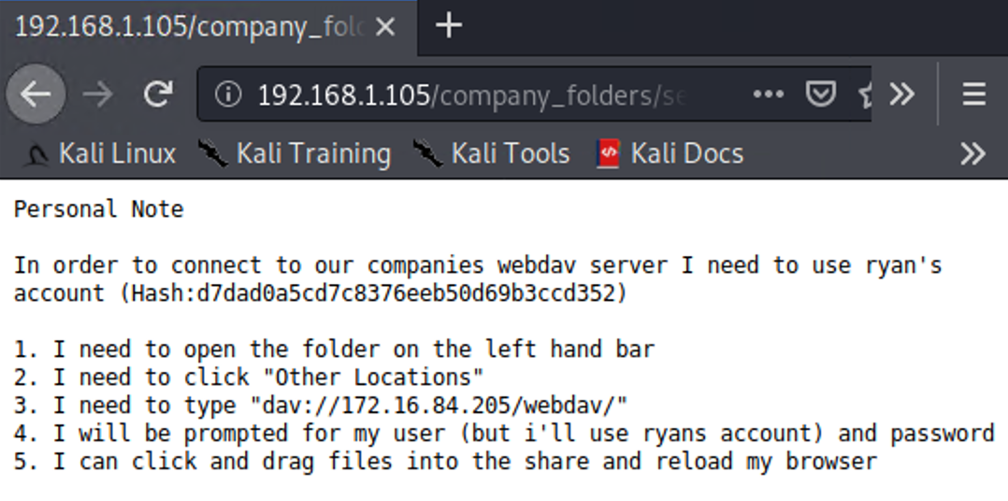
Analysis: Finding the Request for the Hidden Directory
The request occurred on December 6, 2020 at 6:30pm and 15,517 requests were made
The “connect_to_corp_server” file was requested
[Insert Here]
Include a screenshot of Kibana logs depicting the request for the hidden directory.

Slide 15
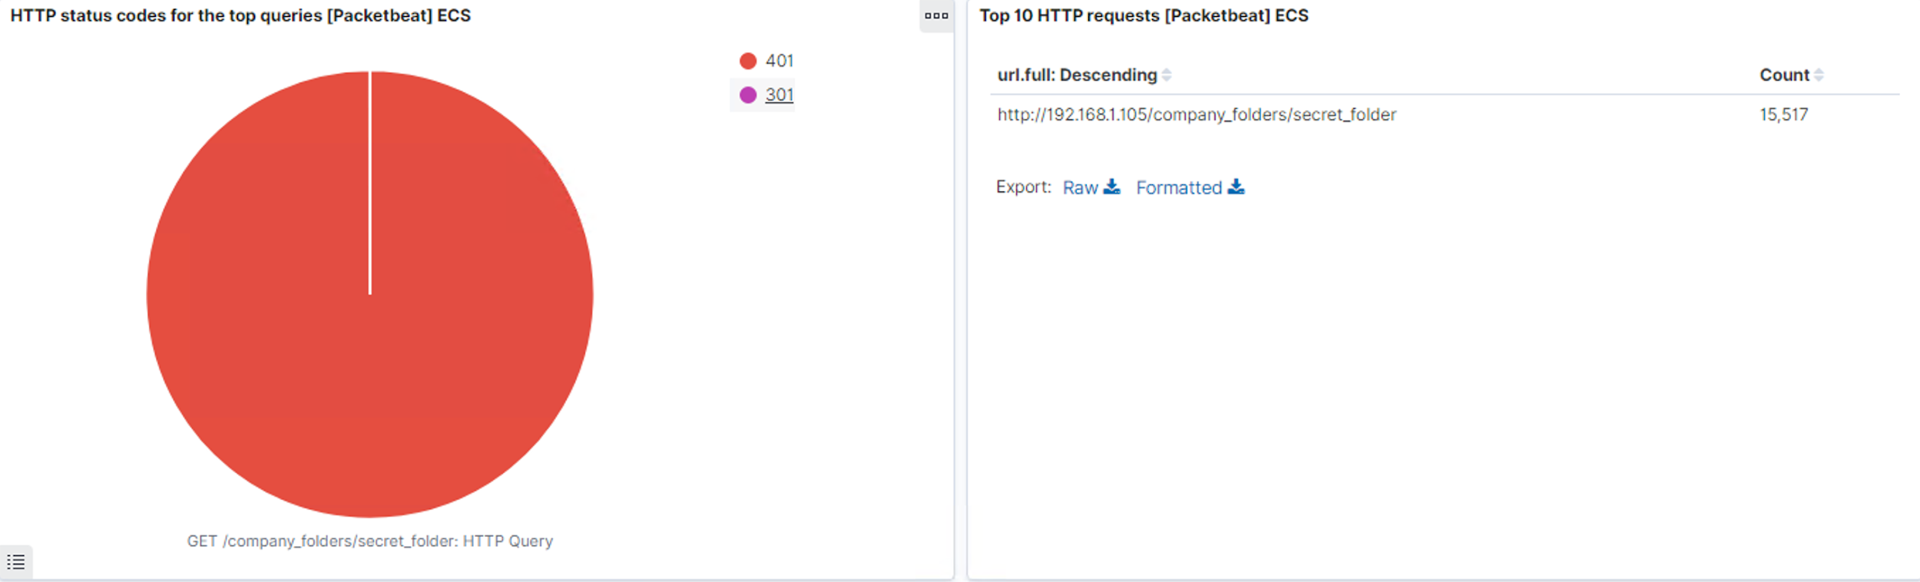
Analysis: Uncovering the Brute Force Attack
15,517 requests were made before discovering the password
HTTP Status 401 unauthorized client error status response code indicates that the request has not been applied because it lacks valid authentication credentials for the target resource
[Insert Here]
Include a screenshot of Kibana logs depicting the brute force attack.

Slide 16
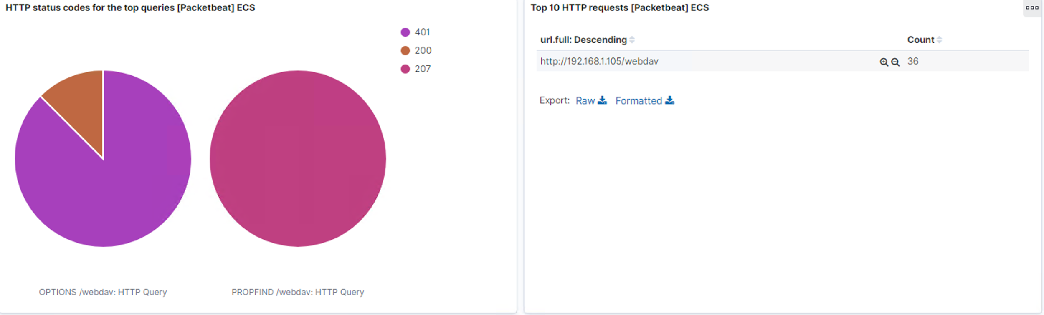
Analysis: Finding the WebDAV Connection
36 request were made to WebDAV
PHP file was requested
[Insert Here]
Add a screenshot of Kibana logs depicting the WebDAV connection.

Slide 17
Blue Team
Proposed Alarms and Mitigation Strategies
‹#›

Slide 18
Mitigation: Blocking the Port Scan
What kind of alarm can be set to detect future port scans?
Maximum number of connections per second
What threshold would you set to activate this alarm?
Maximum 5 requests per second
What configurations can be set on the host to mitigate port scans?
Firewall, Whitelist

Slide 19
Mitigation: Finding the Request for the Hidden Directory
What kind of alarm can be set to detect future unauthorized access?
Alert for any IP address not on the Whitelist
What threshold would you set to activate this alarm?
Any IP address not on the Whitelist
What configuration can be set on the host to block unwanted access?
Restrict privileges to any users
Encrypt all data at rest/transit
Command line:
Nano /etc/httpd/conf/httpd.conf
Allow from 192.168.1.1
Allow from 192.168.1.105
Deny from 192.168.1.90

Slide 20
Mitigation: Preventing Brute Force Attacks
What kind of alarm can be set to detect future brute force attacks?
Restrict number of HTTP Status 401 in 5 second intervals
What threshold would you set to activate this alarm?
Threshold: >5 HTTP Status 401 responses at any time
What configuration can be set on the host to block brute force attacks?
Multilayered login and strong password policy.
Two authentication login
Use a program or system to establish the user is human (ex. Captcha)
Account lockout after 5 failed login attempts for 30 min

Slide 21
Mitigation: Detecting the WebDAV Connection
What kind of alarm can be set to detect future access to this directory?
Alarm set if non whitelisted IP addresses access sensitive files and directories.
What threshold would you set to activate this alarm?
Non whitelisted IP address accesses sensitive files or directories
What configuration can be set on the host to control access?
Block unauthorized access to the WebDAV in /etc/httpd/conf/httpd.conf in the WebDAV directory (/var/www/webdav/)

Slide 22
Mitigation: Identifying Reverse Shell Uploads
What kind of alarm can be set to detect future file uploads?
Alarm set for non whitelisted IP addresses accessing sensitive files on the server
What threshold would you set to activate this alarm?
When “put” request methods are made to access sensitive files from non white listed IP addresses
What configuration can be set on the host to block file uploads?
Block unauthorized HTTP requests in /etc/httpd/conf/httpd.conf in the WebDAV directory (/var/www/webdav/)

